Slide 1
XYZ lexer &GrammaR
5070379019 吴晔
5070379022 杨嘉晨
5070379025 詹恢洲

Slide 2
Lexer Parser Generator
We use SableCC as parser generator
We use SableCC feature State to parse comment

Slide 3
Token Definition (Helpers 1)
Package xyzlex;
Helpers
all= [ 0 .. 0xffff ] ;
letter = ['a'..'z'] | ['A'..'Z'];
digit = ['0' .. '9'];
sp = ' ' ;
cr = 13 ; // carriage return
lf = 10 ; // line feed

Slide 4
Token Definition (Helpers 2)
tab = 9 ; // tab char
bl = sp | cr | lf | tab ;
new_line = cr | lf ;
underscore = '_' ;
plus_c = '+' ;
minus_c = '-' ;
signed_c = plus_c | minus_c ;
e_c = 'E' | 'e' ;

Slide 5
Token Definition (Tokens 1)
States
normal, comment_new_s,comment_old_s;
Tokens
{normal}if_key = 'if';
{normal}else_key = 'else';
{normal}while_key = 'while';
{normal}int_key = 'int';
{normal}real_key = 'real';
{normal}pre_key = 'pre';
{normal}post_key = 'post';

Slide 6
Token Definition (Tokens 2)
{normal}class_key = 'class';
{normal}extends_key = 'extends';
{normal}public_key = 'public';
{normal}static_key = 'static';
{normal}void_key = 'void';
{normal}main_key = 'main';
{normal} new_key = 'new';
{normal}this_key = 'this';
{normal}boolean_key = 'boolean';
{normal}point = '.' ;

Slide 7
Token Definition
{normal}id = letter (underscore | digit | letter)*;
{normal}real_literal = digit* '.' digit* (e_c signed_c? digit+)?;
{normal}integer_literal = digit+;
{normal}operator = ('&&' | '||' | '>' | '<' | '+' | '-' | '*' | '/' | '=' );
{normal}left_brace = '{' ;
{normal}right_brace = '}' ;
{normal}left_bracket = '[';
{normal}right_bracket = ']';
{normal}left_p = '(' ;
{normal}right_p = ')' ;

Slide 8
Token Definition (Tokens 3)
{normal}semicolon = ';' ;
{normal}colon = ':' ;
{normal}blanks = bl*;
{normal -> comment_new_s}
comment_new_style = '//' ;
{normal -> comment_old_s}
comment_old_style = '/*' ;
{comment_old_s -> normal}
comment_old_style_end = '*/';

Slide 9
Token Definition (Tokens 4)
{comment_new_s -> normal}
comment_new_style_end = new_line;
{comment_new_s}
comment_any_n = [all - [cr + lf ]]*;
{comment_old_s}
comment_any_o = [all - ['*' + '/']]*;
{comment_old_s} star = '*';
{comment_old_s} slash_o = '/';
{comment_new_s} slash_n = '/';

Slide 10
Token Definition (Ignored Tokens)
Ignored Tokens
blanks,
comment_new_style,
comment_old_style,
comment_old_style_end,
comment_new_style_end,
comment_any_n,
comment_any_o ;

Slide 11
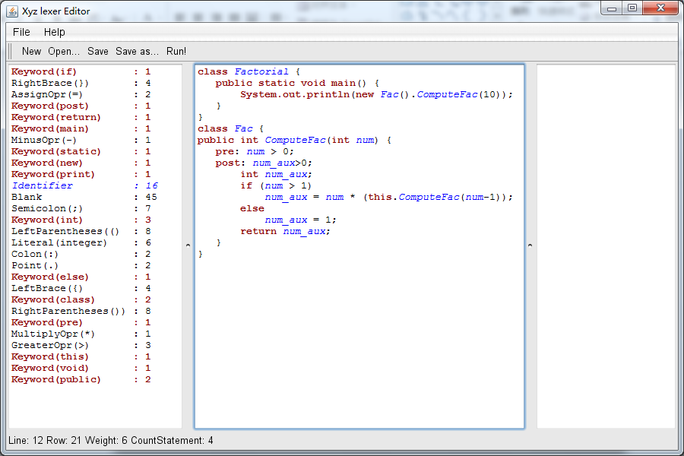
Edit and lexer coloring

Slide 12
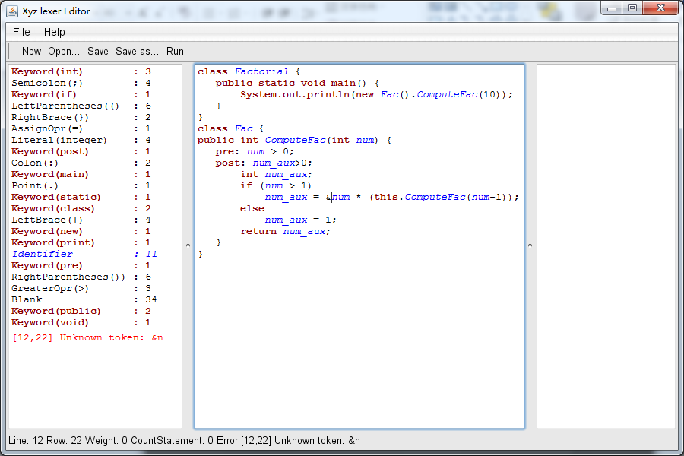
Error Detecting

Slide 13
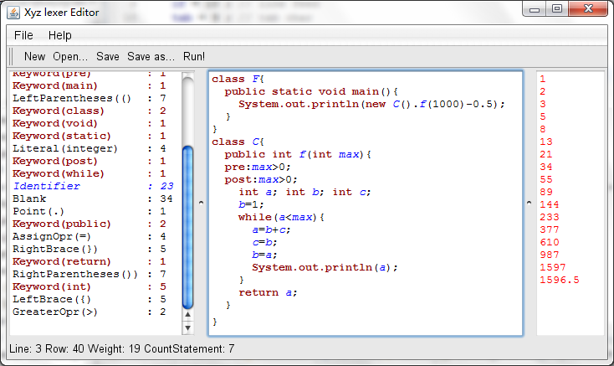
An Interpreter
To verify that our grammar definition can really work.

Slide 14
Left Value
Productions
AST
left_value = {var} id
| {field} [object]:term point [field]:id
| {arr_sub} [array]:term l_sq [index]:exp r_sq;
state= /* … */
| {assign} [target]: left_value assign_opr exp semi
;
left_value = {var} id
| {field} [object]:exp [field]:id
| {arr_sub} [array]:exp [index]:exp ;
state = /* … */
| {assign} [target]: left_value [value]: exp ;
Statement → /* … */
→ id = Exp ;
→ id [ Exp ]= Exp ;

Slide 15
Precedence of operator
exp {-> exp} = {or_opr} [first]:exp or_opr [rest]:exp1
{-> New exp.or_opr(or_opr,first.exp,rest.exp)}
| {single} exp1
{-> exp1.exp}
;
exp1 {-> exp} = {and_opr} [first]:exp1 and_opr [rest]:exp2
{-> New exp.and_opr(and_opr,first.exp,rest.exp)}
| {single} exp2
{-> exp2.exp}
;
exp2 {-> exp} = {not_opr} not_opr [first]:exp2
{-> New exp.not_opr(not_opr,first.exp)}
| {single} exp3
{-> exp3.exp}
;
exp3 {-> exp} = {greater_opr} [first]:exp3 greater_opr [rest]:exp4
{-> New exp.greater_opr(greater_opr,first.exp,rest.exp)}
| {less_opr} [first]:exp3 less_opr [rest]:exp4
{-> New exp.less_opr(less_opr,first.exp,rest.exp)}
| {single} exp4
{-> exp4.exp}
;
exp4 {-> exp} = {plus_opr} [first]:exp4 plus_opr [rest]:exp5
{-> New exp.plus_opr(plus_opr,first.exp,rest.exp)}
| {minus_opr} [first]:exp4 minus_opr [rest]:exp5
{-> New exp.minus_opr(minus_opr,first.exp,rest.exp)}
| {single} exp5
{-> exp5.exp}
;
exp5 {-> exp} = {multiply_opr} [first]:exp5 multiply_opr [rest]:term
{-> New exp.multiply_opr(multiply_opr,first.exp,rest.exp)}
| {divide_opr} [first]:exp5 divide_opr [rest]:term
{-> New exp.divide_opr(divide_opr,first.exp,rest.exp)}
| {single} term
{-> term.exp}
;
term {-> exp} = {int_lt} int_lt{-> New exp.int_lt(int_lt)}
| {real_lt} real_lt {-> New exp.real_lt(real_lt)}
| {true_lt} true {-> New exp.true_lt(true)}
| {false_lt} false {-> New exp.false_lt(false)}
| {this}this{-> New exp.this(this)}
| {sub_exp} l_p exp r_p {-> exp.exp}
| {array_length} [array]:term point length
{-> New exp.array_length(array.exp,length)}
| {mem_func}[object]:term point [func]:id l_p [args]:exp_list? r_p
{-> New exp.mem_func(object.exp,func,[args.exp])}
| {new_int_ar} new int l_sq [size]:exp r_sq
{-> New exp.new_int_ar(size.exp,new)}
| {new_real_ar} new real l_sq [size]:exp r_sq
{-> New exp.new_real_ar(size.exp,new)}
| {new_object} new [type]:id l_p r_p
{-> New exp.new_object(type,new)}
| {left_value}left_value
{-> New exp.left_value(left_value)}
;
left_value = {var} id {-> New left_value.var(id)}
| {field} [object]:term point [field]:id
{-> New left_value.field(object.exp,point,field)}
| {arr_sub} [array]:term l_sq [index]:exp r_sq
{-> New left_value.arr_sub(array.exp,l_sq,index.exp,r_sq)}
;
( exp )
new int [], new real [], new type ()
exp . field , exp . func , exp [exp], exp .length
* /
+ -
> <
!
&&
||
Too Complex
We Need AST
Precedence from high to low

Slide 16
CST vs AST
r=this.func(a1,a2,a3);
AST
assign
assign
Left_value
=
exp
;
Left_value
exp
Id:r
exp
.
Id: func
(
Exp_list
)
this
Exp_list
,
exp
Id:r
exp
Id: func
exp *
Exp_list
,
exp
Id:a3
this
a1
a1
a3
exp
Id:a2
CST
Id:a1

Slide 17
Exp defined in AST
exp = {or_opr} [first]:exp [rest]:exp
| {and_opr} [first]:exp [rest]:exp
| {not_opr} [first]:exp
| {greater_opr} [first]:exp [rest]:exp
| {less_opr} [first]:exp [rest]:exp
| {plus_opr} [first]:exp [rest]:exp
| {minus_opr} [first]:exp [rest]:exp
| {multiply_opr} [first]:exp [rest]:exp
| {divide_opr} [first]:exp [rest]:exp
| {int_lt} int_lt
| {real_lt} real_lt
| {true_lt}true
| {false_lt}false
| {this}this
| {sub_exp} exp
| {array_length} [array]:exp length
| {mem_func}[object]:exp [func]:id [args]:exp*
| {new_int_ar} [size]:exp
| {new_real_ar} [size]:exp
| {new_object} [type]:id
| {left_value}left_value;
left_value = {var} id
| {field} [object]:exp [field]:id
| {arr_sub} [array]:exp [index]:exp;

Slide 18
Other modifications to Grammar
Add exp -> real_literal
Add exp -> new real [exp]
Modify Main method to
method_decl = public type id l_p formal_list? r_p l_b pre_decl post_decl body return exp semi r_b
body = var_decl* state*

Slide 19
Type promotion and cast
In Exp
Int -> real , if one of the operatee is real

Slide 20
Interpreter progress
class F{
public static void main(){
System.out.println(new C().f(1000) -0.5);
}
}
class C{
public int f(int max){
pre:max>0;
post:max>0;
int a; int b; int c;
b=1;
while(a<max){
a=b+c;
c=b;
b=a;
System.out.println(a);
}
return a;
}
}
Program
F -> main
C ->add to class declarations table
F -> add to class C method table
F
Print statement
Minus
Func call -> look table
New C() -> look table
Int max=1000;
Check pre, Jump into f
int a; int b; int c;
b=1;
…
return a;
Check post
Return value – 0.5

Slide 21
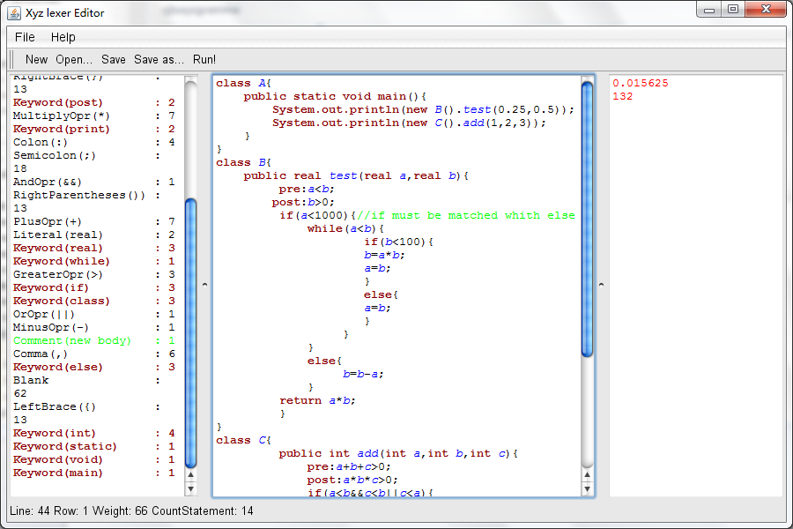
Member functions

Slide 22
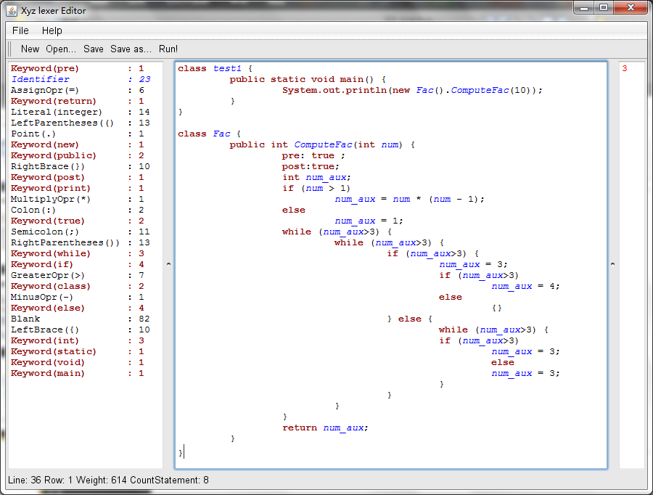
Large Weight Struct

